Slide 1

IOT-ENABLED INTELLIGENT
SEWER MONITORING AND
FLOOD RISK EARLY-WARNING
SYSTEM
Department of Mechanical Engineering
BHUVANAN M | ARAVINTH R | AMBIKA B | DHARANESHWARAN B
KNOWLEDGE INSTITUTE OF TECHNOLOGY TEAM - 9

Slide 2
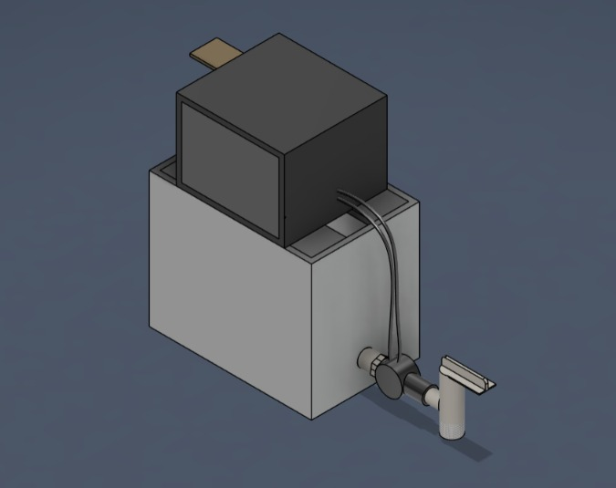
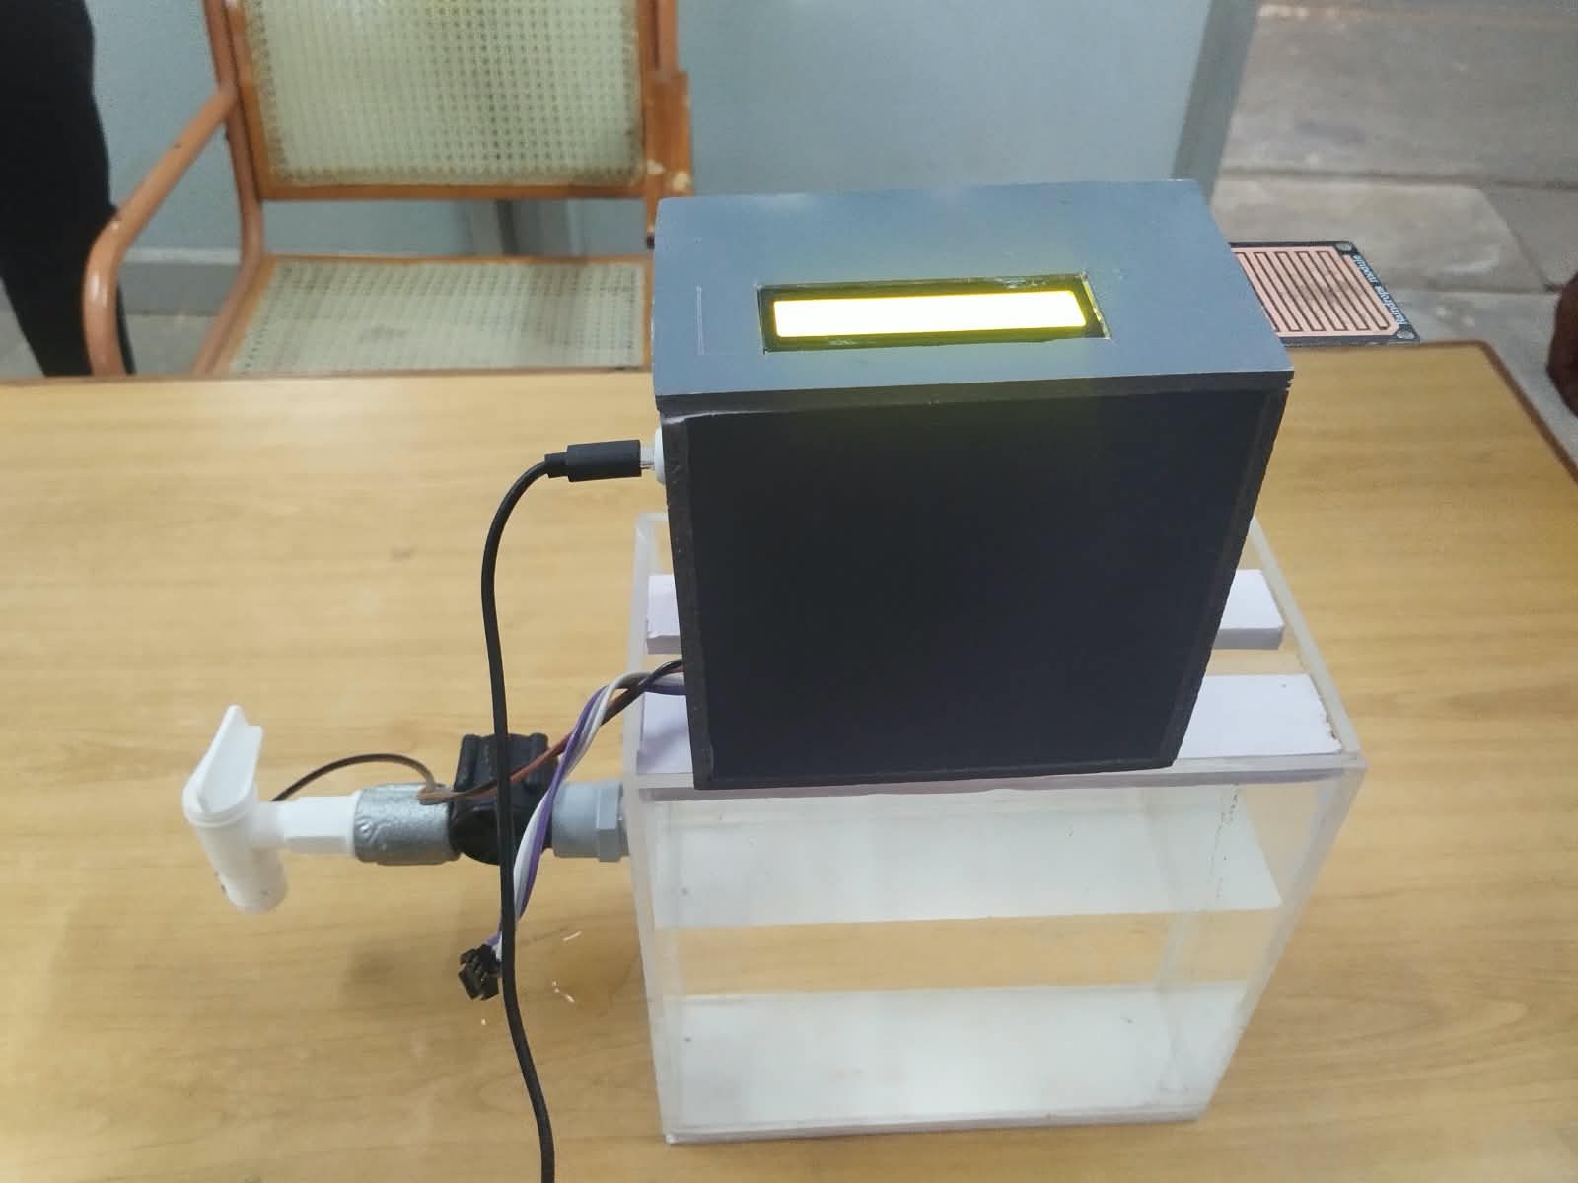
KNOWLEDGE INSTITUTE OF TECHNOLOGY
IOT-ENABLED INTELLIGENT SEWER MONITORING AND FLOOD RISK EARLY-WARNING SYSTEM
Objective: To continuously monitor drainage and sewage conditions using real-time IoT sensor data for early blockage and flood-risk warning.
Solution: An integrated system using an ESP8266 NodeMCU, HC-SR04 ultrasonic sensor, YF-S201 water-flow sensor, rain sensor module, I2C LCD, and a Wi-Fi web dashboard.
Impact: Reduces manual inspection, enables early detection of blockage and overflow, and supports timely preventive maintenance for safer urban drainage.
ISOMETRIC VIEW
PROTOTYPE
2

Slide 3
KNOWLEDGE INSTITUTE OF TECHNOLOGY
Engineering Design Process
1
2
3
4
Problem
Identification
Requirement
Analysis
Concept
Development
System
Design
5
6
7
8
Prototype
Development
Testing &
Validation
Optimization
Final
Evaluation
3

Slide 4
KNOWLEDGE INSTITUTE OF TECHNOLOGY
Process Table
Phase | Activity | Outcome
Water-Level Sensing | Ultrasonic sensor (HC-SR04) measures distance to the water surface | Water level data sent to ESP8266
Flow Sensing | YF-S201 flow sensor generates pulses proportional to water movement | Flow rate calculated; restriction identified
Rain Sensing | Rain sensor detects water droplets on its sensing plate | Rainfall status identified for flood-risk check
Data Processing | ESP8266 compares sensor readings with predefined threshold values | Drainage status determined (Normal / Blockage / Overflow)
Data Display | 16×2 I2C LCD shows water level, flow, rain status, and system status | Real-time local monitoring enabled
Remote Monitoring | ESP8266 sends processed data to the web dashboard over Wi-Fi | Remote monitoring and warning alerts via dashboard
4

Slide 5
KNOWLEDGE INSTITUTE OF TECHNOLOGY
List of Activities
Literature Survey: Reviewed existing IoT-based drainage and flood monitoring systems and identified research gaps.
Component Selection & Procurement: Selected ESP8266, HC-SR04, YF-S201, rain sensor, and LCD based on cost, accuracy, and compatibility.
Circuit Design & Assembly: Interfaced all sensors with the ESP8266 NodeMCU and assembled the wiring on the prototype.
Firmware Development: Programmed the ESP8266 using Arduino IDE with threshold-based condition logic.
Dashboard Development: Built a web-based dashboard for live monitoring, warning display, and CSV data export.
Prototype Fabrication & Testing: Built the drainage-channel prototype and validated it under normal, blockage, overflow, and rainfall conditions.
PROTOTYPE BUILD
5

Slide 6
KNOWLEDGE INSTITUTE OF TECHNOLOGY
Activity Duration Table
Activity ID | Task Description | Duration
A1 | Literature Survey & Requirement Gathering | 1 Week
A2 | Component Selection & Procurement | 1 Week
A3 | Sensor Interfacing & Circuit Wiring | 2 Weeks
A4 | Arduino IDE Programming & Threshold Logic | 2 Weeks
A5 | Web Dashboard Development | 2 Weeks
A6 | Prototype Fabrication & Assembly | 2 Weeks
A7 | System Integration & Testing | 2 Weeks
6

Slide 7
KNOWLEDGE INSTITUTE OF TECHNOLOGY
Activity Precedence Table
Activity | Preceded By | Logic
Component Procurement | Literature Survey | Requirements must be finalized before ordering parts
Circuit Wiring | Component Procurement | Components must be available before assembly
Firmware Programming | Circuit Wiring | Hardware must be wired before code can be tested
Dashboard Development | Firmware Programming | Data format must be defined before building the dashboard
Prototype Fabrication | Circuit Wiring | Physical structure is built around the wired components
System Testing | Dashboard Development, Prototype Fabrication | Integration testing follows once all subsystems are ready
7

Slide 8
KNOWLEDGE INSTITUTE OF TECHNOLOGY
Glossary
IoT (Internet of Things):
Network of physical devices connected for real-time data exchange over the internet.
ESP8266:
Low-cost Wi-Fi enabled microcontroller used as the main control and communication unit.
HC-SR04:
Ultrasonic distance sensor used to measure the water level inside the drainage channel.
YF-S201:
Hall-effect water-flow sensor that generates pulses proportional to the flow rate.
Rain Sensor Module:
Sensor that detects the presence and intensity of rainfall for flood-risk assessment.
Threshold Value:
Predefined limit used by the ESP8266 to classify drainage conditions as normal or abnormal.
8

Slide 9
KNOWLEDGE INSTITUTE OF TECHNOLOGY
Science Principles
Ultrasonic Echo Principle:
Distance is measured from the time taken for a transmitted ultrasonic wave to reflect off the water surface and return to the sensor.
Hall-Effect Sensing:
A rotor inside the flow sensor generates electrical pulses proportional to the rate of water flow as it turns.
Conductivity-Based Sensing:
The rain sensor's output changes as water bridges the conductive tracks on its exposed sensing plate.
Wireless Communication:
The ESP8266 uses 802.11 Wi-Fi (TCP/IP) to transmit sensor data to the web dashboard in real time.
9

Slide 10
KNOWLEDGE INSTITUTE OF TECHNOLOGY
Concept Rules & Laws
Threshold Rule: A warning is triggered only when water level or flow rate crosses a predefined critical limit.
Automation Rule: Sensor → ESP8266 → LCD/Dashboard data flow requires no manual intervention.
Feedback Monitoring Law: Continuous sensor feedback allows the system to reclassify drainage status in real time as conditions change.
IoT Data Principle: Real-time sensor data streams continuously to the web dashboard for remote access, warnings, and CSV logging.
10

Slide 11
KNOWLEDGE INSTITUTE OF TECHNOLOGY
Constants & Variables
CONSTANTS
VARIABLES
ESP8266 Clock Speed: 80 MHz
Sensor Supply Voltage: 3.3 – 5 V
HC-SR04 Operating Voltage: 5 V
LCD Size: 16 × 2 (I2C interface)
Total Project Cost: ₹ 2,820 (approx.)
Water Level (cm): varies with drainage condition
Flow Rate (L/min): changes with water movement
Rainfall Status: ON / OFF from rain sensor
Drainage Status: Normal / No Flow / Blockage
Overflow / Flood Risk
11

Slide 12
KNOWLEDGE INSTITUTE OF TECHNOLOGY
Key Equations
System Logic Model
Sensor Readings → ESP8266 Processing → Threshold Check → LCD / Dashboard Update → Warning Trigger
Water-Level Calculation: Water Level = Sensor Mounting Height − Measured Distance (from HC-SR04 echo time)
Blockage Decision: IF (Water Level > High Threshold) AND (Flow Rate < Low Threshold) THEN Blockage Warning
Flood-Risk Decision: IF (Water Level > Critical Threshold) AND (Rain = Detected) THEN Flood-Risk Alert
Sensor Accuracy (tested): Water-level measurement accuracy ≈ ± 0.2 cm (Table 8.1 trial results)
12

Slide 13
KNOWLEDGE INSTITUTE OF TECHNOLOGY
What-If Analysis
Q1: What if Wi-Fi disconnects?
The system continues local operation; the LCD keeps displaying live readings while the ESP8266 automatically retries the connection.
Q2: What if a sensor gives a faulty reading?
Threshold-based logic reduces false alarms; the affected sensor should be inspected and recalibrated periodically.
Q3: What if the power supply fails?
Monitoring stops until power is restored; a battery backup can be added to prevent gaps in monitoring.
Q4: What if the drainage size or flow rate changes?
Threshold values in the firmware can be updated for different pipe or channel dimensions.
13

Slide 14
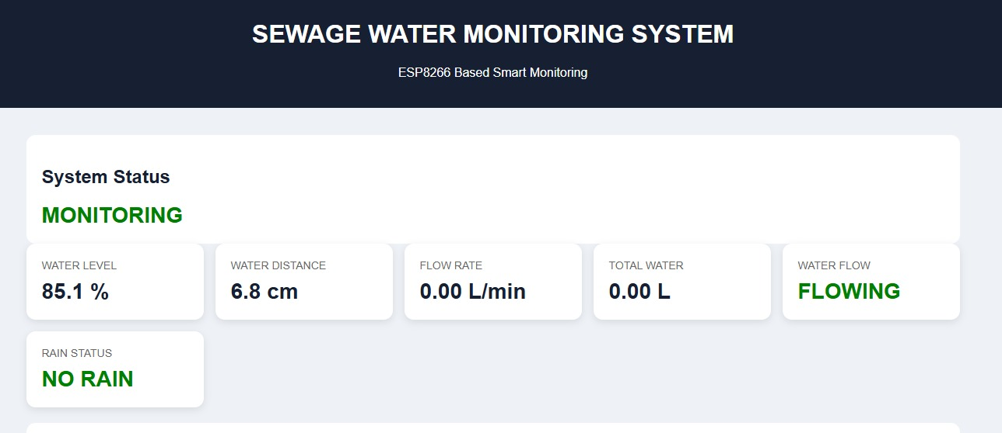
KNOWLEDGE INSTITUTE OF TECHNOLOGY
Conclusion
The IoT-Enabled Intelligent Sewer Monitoring and Flood Risk Early-Warning System successfully demonstrates a low-cost, real-time drainage monitoring approach using an ESP8266 NodeMCU with ultrasonic, water-flow, and rain sensors. The prototype accurately measures water level, detects flow restrictions, and identifies rainfall to classify drainage status as Normal, No Flow, Blockage, Overflow, or Flood Risk. A 16×2 I2C LCD provides local monitoring, while a Wi-Fi web dashboard delivers live readings, graphs, warning alerts, and CSV data export for remote monitoring.Testing confirmed reliable detection of blockage and overflow conditions, validating the system as a practical, scalable foundation for smart-city drainage and flood-prevention networks.
THANK YOU
14

